Slide 1
Capacity Building Programme on Proposal Presentation for Research Grants, Patents and High Impact Publications Organized by Directorate of Research, IQAC & UGC-MMTTC, Bharathidasan University TOPIC: IPR AND PATENTS: PERSPECTIVES AND PROSPECTS Presented by Dr. M. Mahindra Prabu Dean, UG Academics Tamil Nadu National Law University, Tiruchirappalli

Slide 2
Understanding Intellectual Property Rights (IPR)
What is IPR?
Legal rights granted to creators and inventors to protect their intellectual creations of the human mind.
Difference between IP and IPR
Why is it significant?
1 per cent improvement in the protection of trademark, patent and copyright increases FDI by 3.8, 2.8 and 6.8 per cent, respectively.
See Review of the Intellectual Property Rights Regime in India [2021],169th Report - Rajya Sabha
How is it created, regulated, and used in business?
Is it national or international?

Slide 3
Intersection of science, law, and management
Element | Discipline | Essence
Creativity | Science & Innovation | Generation of new ideas, inventions and expressions through research and imagination
Protection | Law & Policy | Legal recognition and protection of intellectual creations
Commercialisation | Management & Business | Commercialisation and exploitation of intellectual property in markets

Slide 4
The Legal Dimensions of IP
Intellectual Property | Represents Individual Creativity and Innovation
 | Individual Effort
Intellectual Property Rights | Legal acknowledgement and protection granted to creators and inventors
 | Societal Recognition
Laws Related to Intellectual Property Rights | Framework through which society institutionalizes recognition and enforcement of intellectual property rights.
 | Societal Recognition in the form of laws

Slide 5
Significance of Intellectual Property Rights
Knowledge Economy | Innovation-driven economic value
Intangible Property | Non-physical creations of the mind
Commercialisation | Conversion of ideas into market assets
Private Property Rights | Ownership and recognition of creators
Economic Asset | Ability to trade, assign, or license IP rights
Promotes Investment | Attracts funding and R&D initiatives
Volatile | Dynamic (adapting to changes in technology, markets, and law)

Slide 6
Forms of IPR
Patent or Disclosed Information
Trade secret or confidential/undisclosed information
Copyright & Related Rights
Design
Semiconductor Integrated Circuit Layout Design
Trademark
Geographical Indication
Plant Variety Protection
Function
Anything Commercially Valuable
Expression
Attraction
Chip Architecture
Identity
Origin based Reputation
Breeder and Farmer Rights

Slide 7
Laws relating to IPRs in India
Forms of IPRs | Relevant Statute
Trade secret or confidential information | The Indian Contracts Act, 1872
Patents | The Patents Act, 1970 The Biological Diversity Act, 2002 (Patent application involving Indian biological resources)
Copyright & Related Rights | The Copyright Act, 1957 The Information Technology Act, 2000
Industrial Designs | The Designs Act, 2000
Trademarks | The Trade Marks Act, 1999 Passing Off Action: Common Law Remedy
Geographical Indications | The Geographical Indications of Goods (Registration and Protection) Act, 1999
Plant Variety Protection | The Protection of Plant Varieties and Farmers' Rights Act, 2001

Slide 8
Regulatory & Institutional Framework in India
Regulatory Framework (Refer to www.ipindia.gov.in)
Rules
Manuals
Guidelines
Institutional Framework
DPIIT (Department for Promotion of Industry and Internal Trade)
Nodal body for IPR policy formulation and coordination.
Cell for IPR Promotion and Management (CIPAM)
CGPDTM (Controller General of Patents, Designs & Trade Marks)
Responsible for patent, design, and trademark registration.
NIPAM – National Intellectual Property Awareness Mission
Indian Copyright Office
Geographical Indications Registry
National Biodiversity Authority

Slide 9
Who owns the IPRs?
Creator, Owner, Licensing and Assignment
HEI, Professor, student, researcher, or joint ownership?
Importance of institutional (HEI) IPR policies
Disclosure obligations before publishing
IP Commercialisation
University of California: Over $700 million in gross licensing revenue (2023)
MIT: Generated $1.2 billion in startup equity from IP over 30 years.

Slide 10
What is a patent?
It belongs to the family of Intellectual Property Rights
Literae patentes – Letters Patents i.e. it implies openness and accessibility
A patent is a statutory right [S.2(1)(m)] granted by a sovereign state to an inventor for his invention, which may relate to a new product or a process for a limited period of time, i.e. 20 years, in exchange for detailed public disclosure of an invention.
It confers a bundle of rights, including the right to exclude others from manufacturing, using, offering for sale, selling or importing the invention in India [S.48]

Slide 11
What Patent Protects?
Inventions and Innovations
Inventions
Creation of a product or introduction of a process for the first time
Innovations
Creative destruction of an invention
Improvements or significant contributions to existing inventions.
Alexander Graham Bell and Steve Jobs
Notes:
If the invention is a pebble tossed in the pond, innovation is the rippling effect that pebble causes. Someone has to toss the pebble. That’s the inventor. Someone has to recognize the ripple which will eventually become a wave. That’s the entreprenuer

Slide 12
Patentability Requirements
Patentable subject matter
Novelty
Inventive Step
Industrial Applicability
Specification
(Grant of Patents is the cumulative effect of all the requirements)

Slide 13
A patent is not a monopoly, and an inventor is not a monopolist, but a public benefactor

Slide 14
IPR life cycle
Global Commons
New Idea = IP
(Anti Commons)
Fixation
Property Rights
Intangible/Personal/Private
Term Protection

Slide 15
Publication v. Patent Filing
It is always advisable and safe to file a patent application first and then publish later.
S. 31 of the Indian Patent Act: If the application for the patent is made by the true and first inventor or a person deriving title from him not later than twelve months after the opening of the exhibition or the reading or publication of the paper shall not be deemed to be anticipated.
Novelty v. Anticipation
First to File v. First to Invent
Filing Strategy

Slide 16
Steps to follow (before filing the patent application)
What is my invention? How does it work?
What problem is my innovative idea solving?
How is my invention different or improved from all other competitors in the same field?
What are the important elements or components of my invention?
Can I draw a block diagram, a device, a flowchart, or a sketch that explains my invention in a better way?
Prior Art Search
Consultation with Patent Agent – Drafting Purpose
Must Remain Confidential until filing

Slide 17
How to Start?
Where to look for previously granted patents? [Prior Art Search]
Patent Search – IPO - InPASS
Espacenet
EPO – Searching for patents
Google Patents
WIPO – Patentscope

Slide 18
Recent Trends in IP Filing with special reference to Patents

Slide 19
National IPR Policy (2016)
IPR AWARENESS
GENERATION OF IPRs
LEGAL & LEGISLATIVE FRAMEWORK
ADMINISTRATION & MANAGEMENT
COMMERCIALISATION OF IPR
ENFORCEMENT & ADJUDICATION
HUMAN CAPITAL DEVELOPMENT

Slide 20
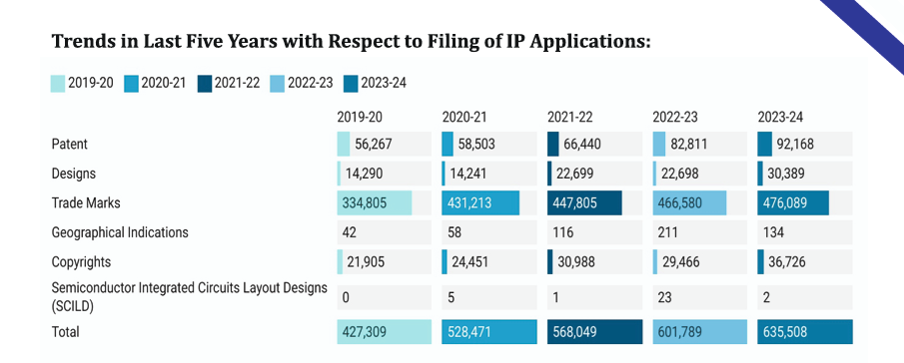
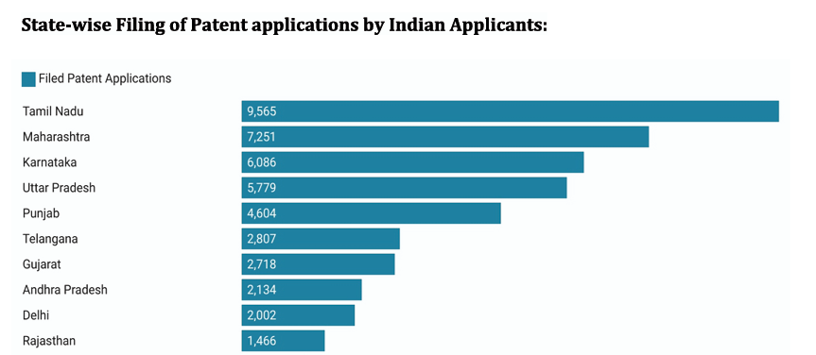
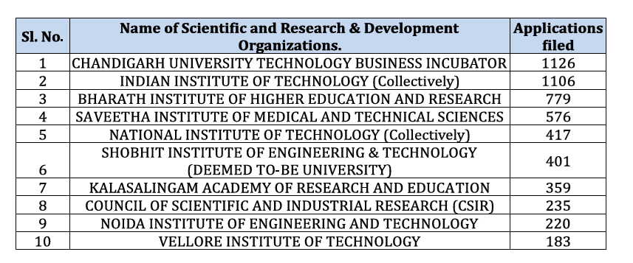
Indian IP Office Annual Report (2023-24)

Slide 21
WIPO Global Innovation Index [2025]
Patent Filing: India (2024 Status)
National Filing: 6th Rank (Global)
International Filing – PCT: 9th Rank (Global)
4547 out of 76470 (6%)
Share of university applications (2022-2024): 4%
Share of women inventors (2022-2024): 12%

Slide 22
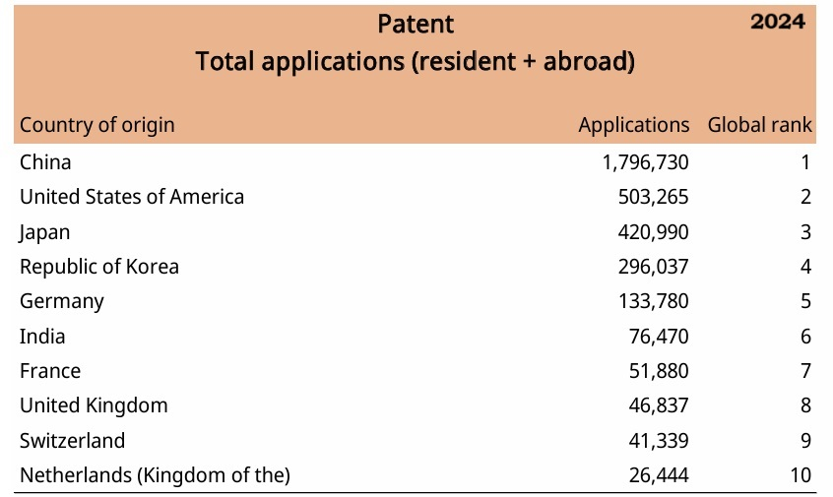
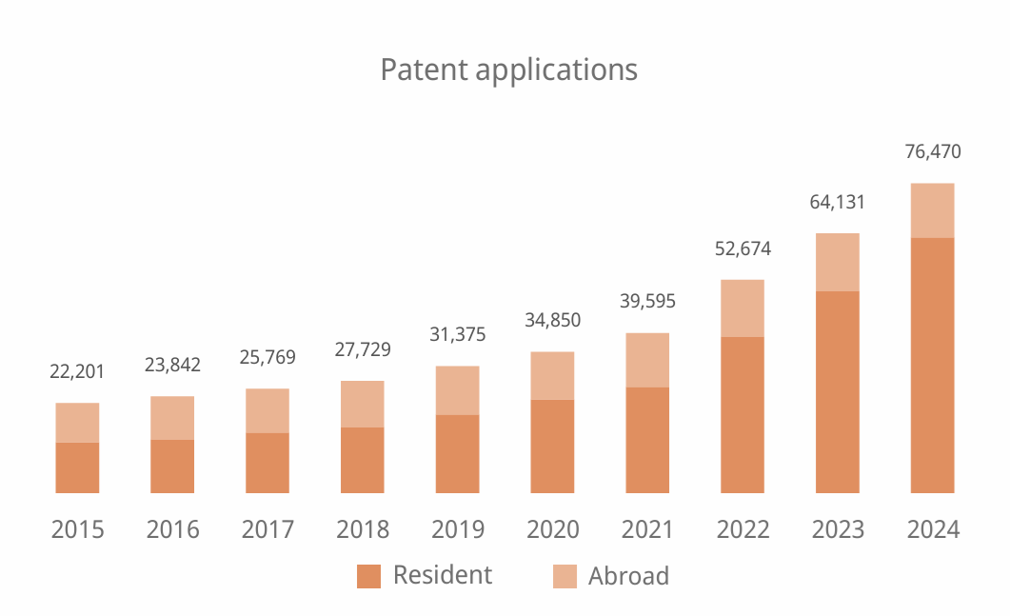
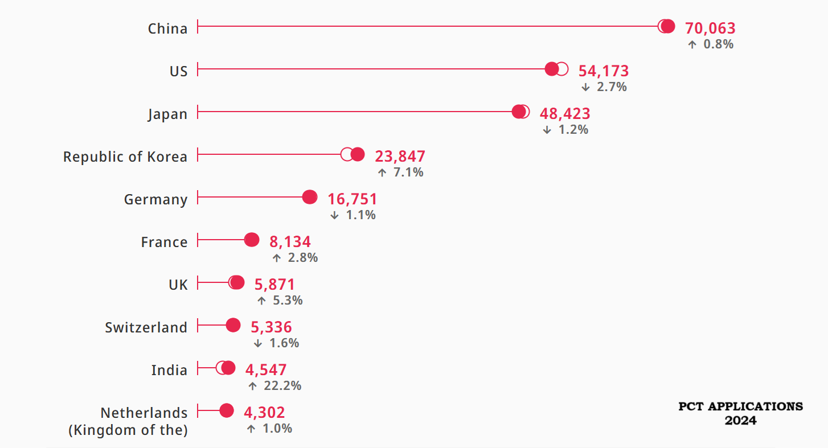

Slide 23
Thank You
I welcome your Questions!
Q&A Session

